Slide 1
07 | Scaling Your Application Under Load
James Chambers | @CanadianJames
Simon Timms | @stimms

Slide 2
Course Topics
Applications on Azure: Putting the Pieces Together
01 | Introduction | 05 | Azure Storage
02 | Application Architecture | 06 | Docker and Log Management
03 | DNS | 07 | Scaling Your Application Under Load
04 | Batch | 08 | Review and Summary

Slide 3
Course Topics
Applications on Azure: Putting the Pieces Together
01 | Introduction | 05 | Azure Storage
02 | Application Architecture | 06 | Docker and Log Management
03 | DNS | 07 | Scaling Your Application Under Load
04 | Batch | 08 | Review and Summary

Slide 4
Module Overview

Slide 5
Module Overview
Horizontal vs Vertical Scaling
Architecture Concerns
Stress Testing to Find Bottlenecks

Slide 6
Types of Scale

Slide 7
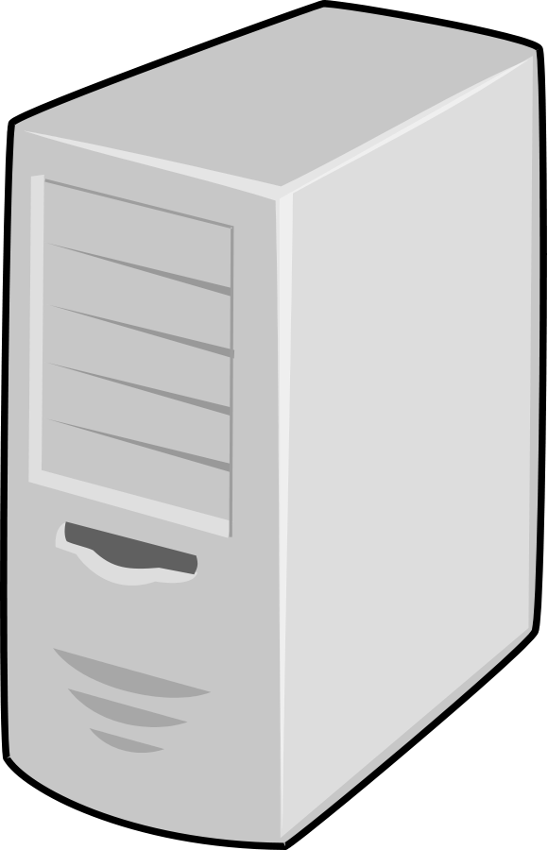

Theories of Scale – Vertical
Big apps need big power
Simplified architecture
Hard disks are cheap
Processors are cheap

Slide 8
Theories of Scale – Horizontal
Small tasks need little power
Well-architected services remain simple
Only pay for storage when you need it
Only pay for processing time you use

Slide 9
Architecting for Scale

Slide 10
Some Assembly Required
Cloud is an enabler for scalability
Your architecture needs to support it
Lift & shift not supported

Slide 11
?

Slide 12
Identifying Bottlenecks

Slide 13
Why Perform Load Testing?
Exposes application bottlenecks
Proves architectural decisions
Identifies regional issues and operational insights
Repeatable
It’s not as hard as it used to be!
Notes:
Not hard:
- don’t have to set up a lab/infrastructure
- samples to get you started

Slide 14
To the cloud!

Slide 15
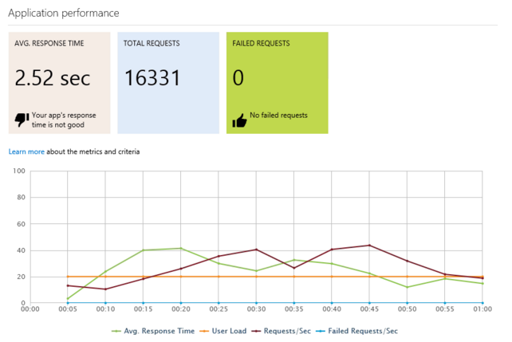
Concerns, Best Practices, Tips
Better tests = better data
Focus on the pieces where latency is a concern
Use load test results as a deployment gate

